Slide 1
UNHCR
Einstein Implementation Walkthrough

Slide 2
Requirement overview
Steps
Export Entities from Salesforce | Contact (Main Entiity)
 |  | Opty
 |  | Donations
 |  | Cases
Filter Contacts based on different campaign critera |  | 30 scenarios (each has 8-15 criteria)
Download in Excel. |  | Using Share option

Slide 3
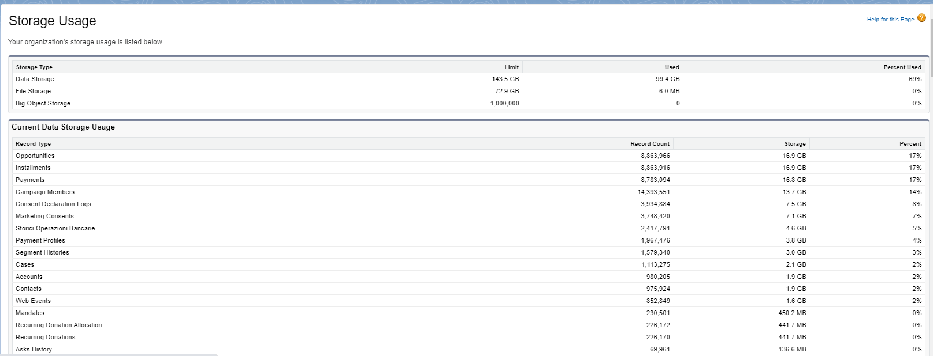
Entity Objects data storage

Slide 4
Design Diagram
UNHCR Salesforce NSP
Incremental Sync
Marketing Consent | Payment Profile | Campaign | Campaign Member | Payment | Account | Donations Allocation | Donations | Opportunity | Case
Base Dataflow
(UNHCR_DF – Base)
Recipe for Single Opty
(UNHCR-Opty_Recipe)
Recurring Donations
(UNHCR-Don_Recipe)
Dashboard 1
Dashboard 2
Re-Activation
3 Data flows
Retention
Upgrade
6 Data flows
Recapturing
Cross-Sell
Recapturing 2nd Time
Conversion

Slide 5
Entity Objects and their Relation
Objects | Relation with Contact | Criteria
Marketing Consent | M:1 | Inclusion
Payment Profile | "1:1" | Inclusion
Campaign | "1:1" | Inclusion
Campaign Member | "1:1" | Inclusion
Payment | M:1 | Inclusion
Account | M:1 | Inclusion
Donations Allocation | M:1 | Inclusion
Donations | M:1 | Inclusion and Exclusion
Opportunity | M:1 | Inclusion and Exclusion
Case | M:1 | Inclusion and Exclusion

Slide 6
Design Approach Approach
%j
.
Requirement | Einstein Capability | Reason
Join Objects for Inclusion | Dataflow | Augment Functionality of Dataflow Creation of Multiple Datasets
Join Object for 1:M relation that has exclsuion | Recipe | Inner Join Functionality of Recipe
Conditions with less performance impact | Queries in Dashboard | For Free Filter and easier BA modification

Slide 7
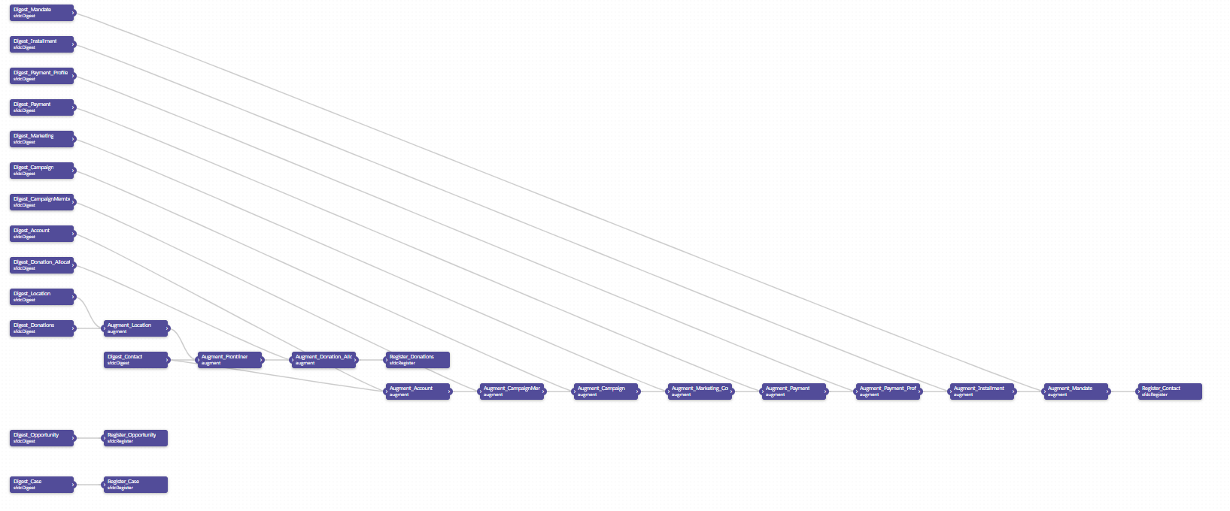
Base Dataflow

Slide 8
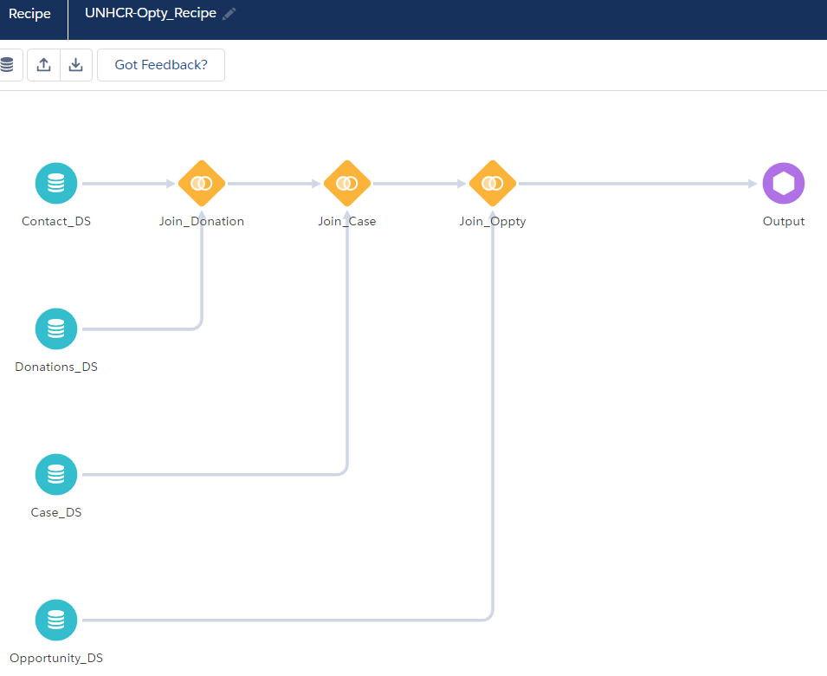
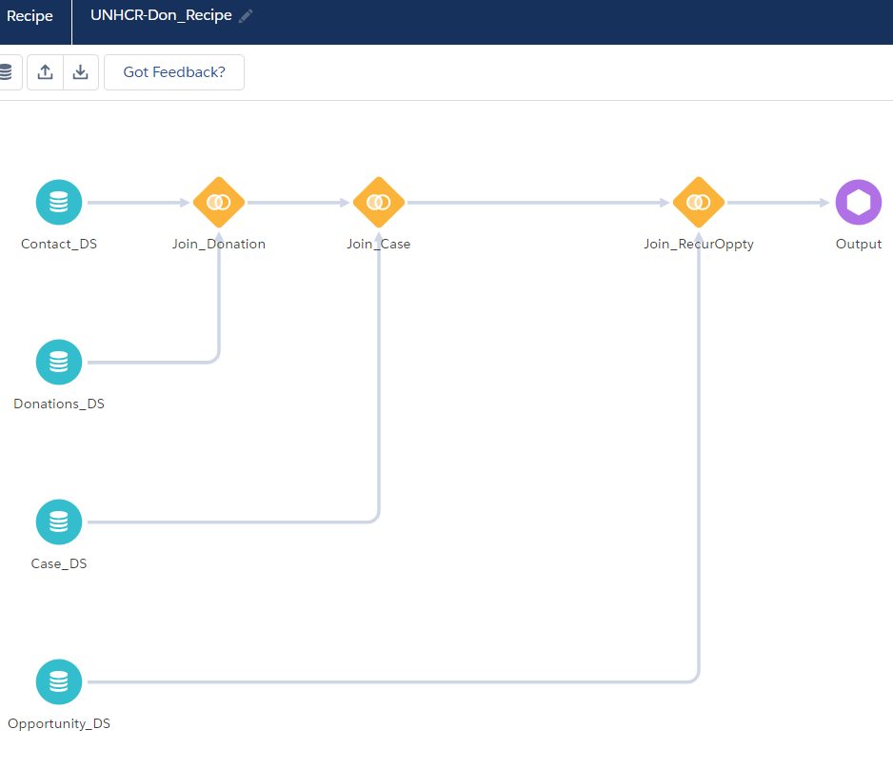
Recipe Approach
Challenge | Decision
Each dataset can have only 20 Billion rows. But Joining Oportunities with recurring donation increaed the count. | Have 2 separate datasets for Single Opty and recurring Opties using 2 Recipes

Slide 9
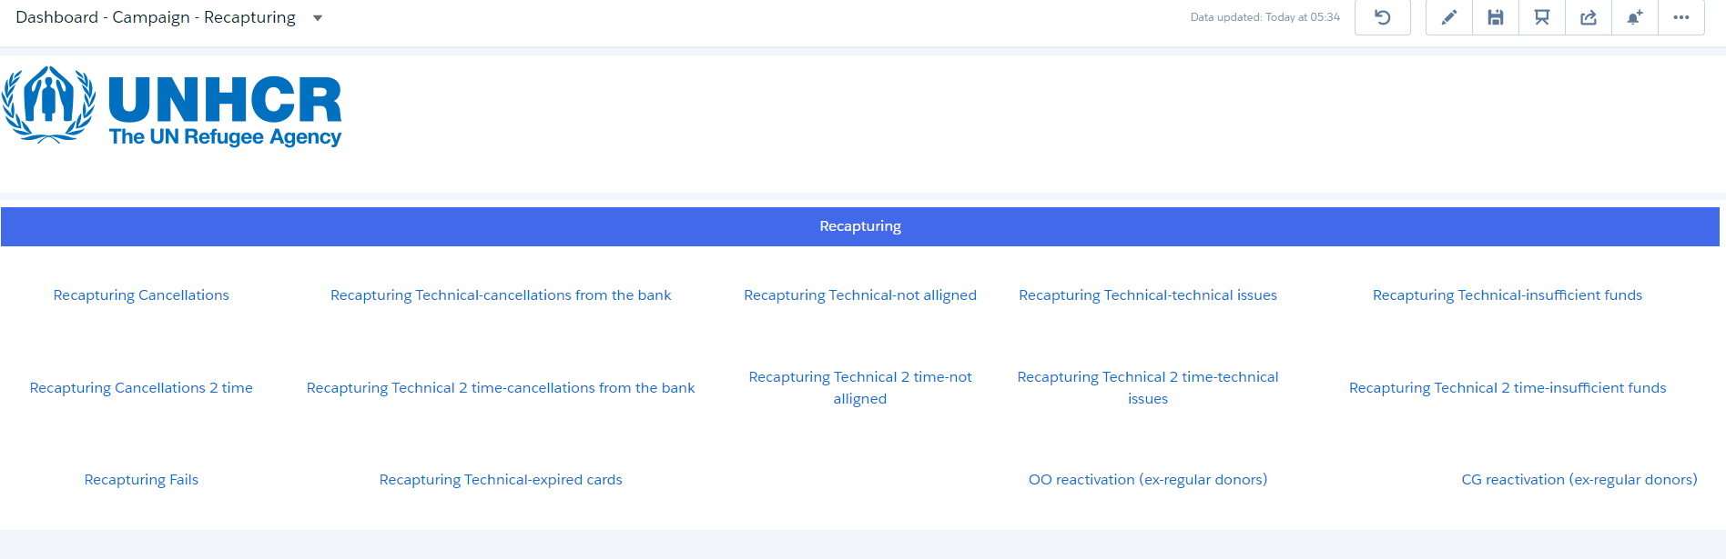
Dasboard Approach -Pg1
Challenge | Decision
Each dashboard can have only 20 Pages. We would need 30 pages in dashboard | Have 2 separate Dashboard organized based on categories

Slide 10
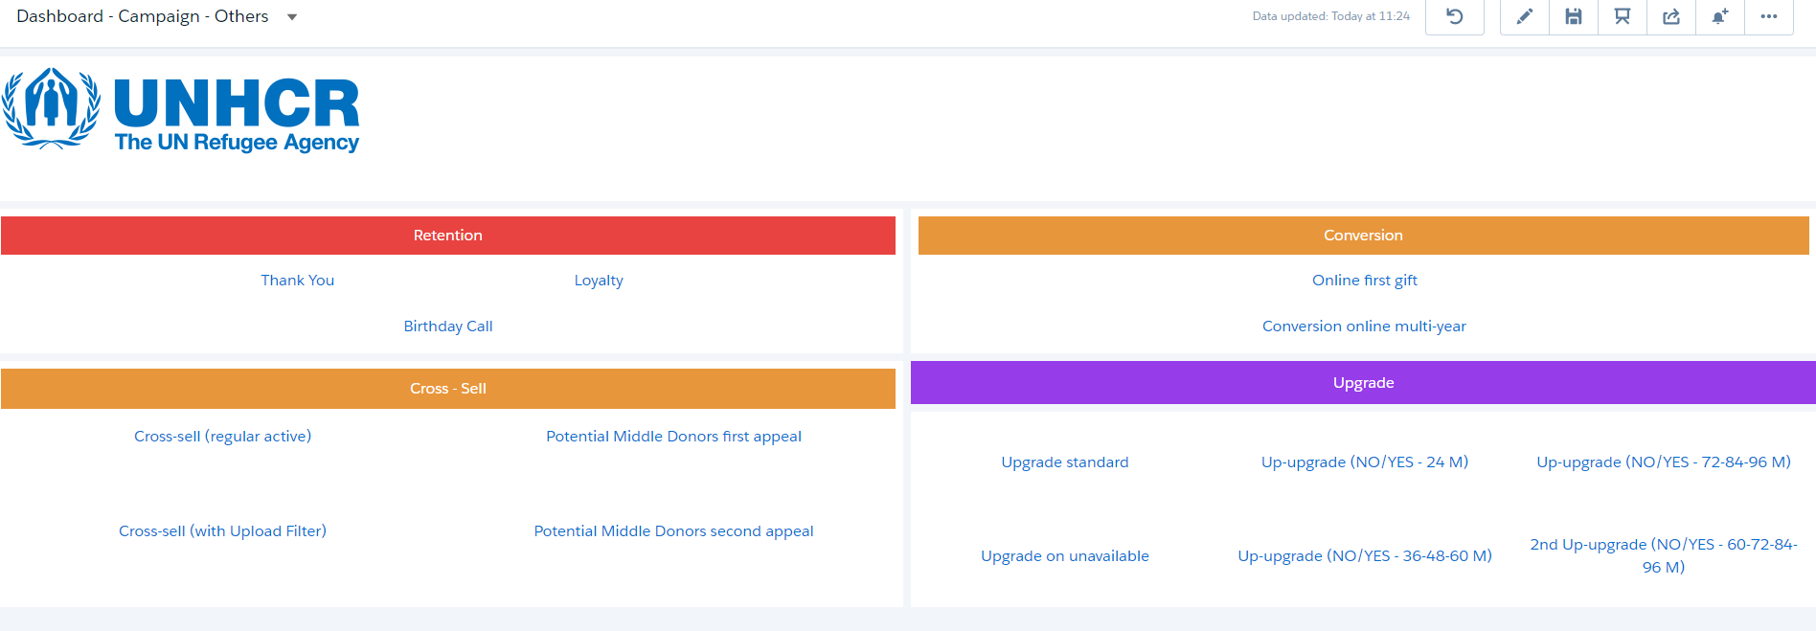
Dasboard Approach -Pg2
Challenge | Decision
Each dashboard can have only 20 Pages. We would need 30 pages in dashboard | Have 2 separate Dashboard organized based on categories

Slide 11
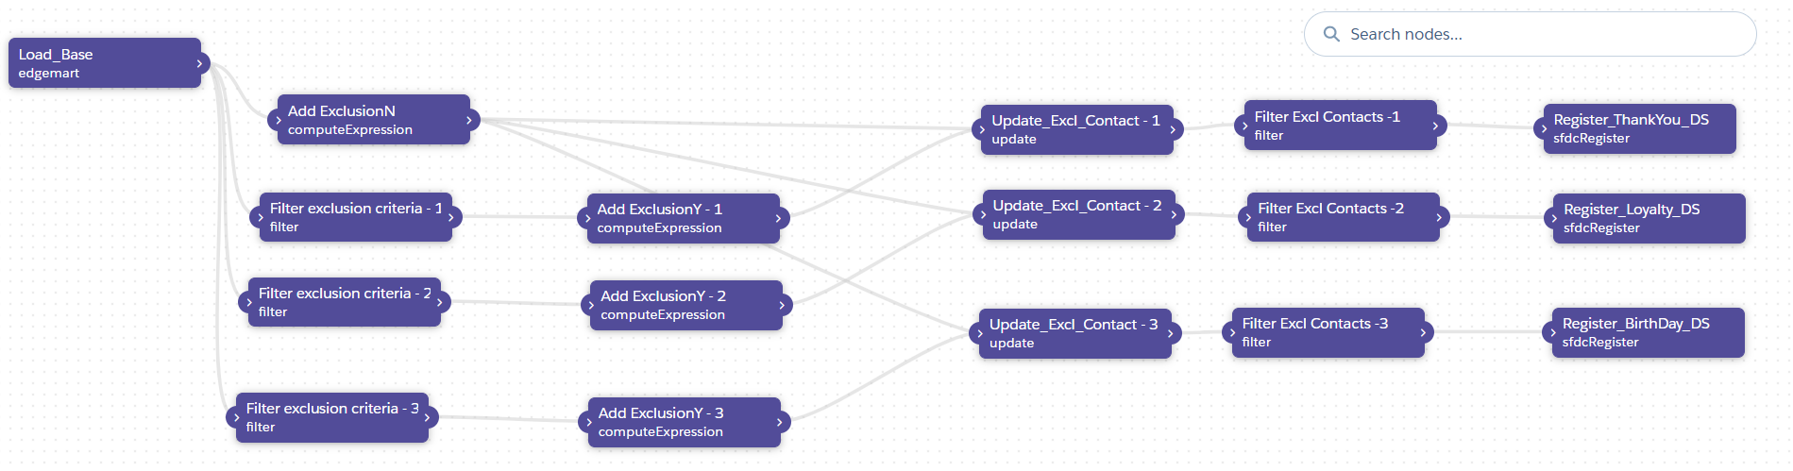
Dataflow Approach Page 1
Challenge | Decision
Exclude Contacts based on child entity criteria. Create Multiple Dataflow and use Update Step exclude contacts. 2) Having one flow for each will result 30 Dataflows but Einstein dataflows executes only Sequentially | 1) Group the Dataflows for similar Exlcusion criteria 2) Handle the inclusion on separately Dashboard queries
Common Exclusion criteria with Parallel flows for Similar Campaign Scenarios

Slide 12
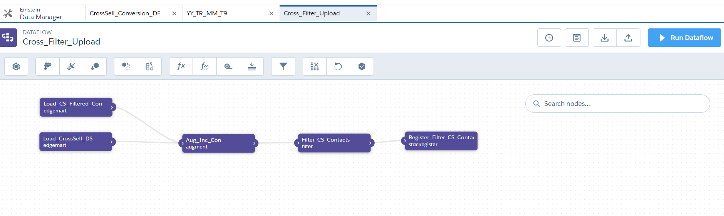
Dataflow Approach Page 2
Challenge | Decision
Include Contacts based on file upload. Joining datasets on Dashboard using Co-group gives Time out issue | 1) Use Datasets to upload the csv containing contacts to filter 2 ) Use Filter criteria in Dataflow.
Upload Contacts via csv and Filter them in.

Slide 13
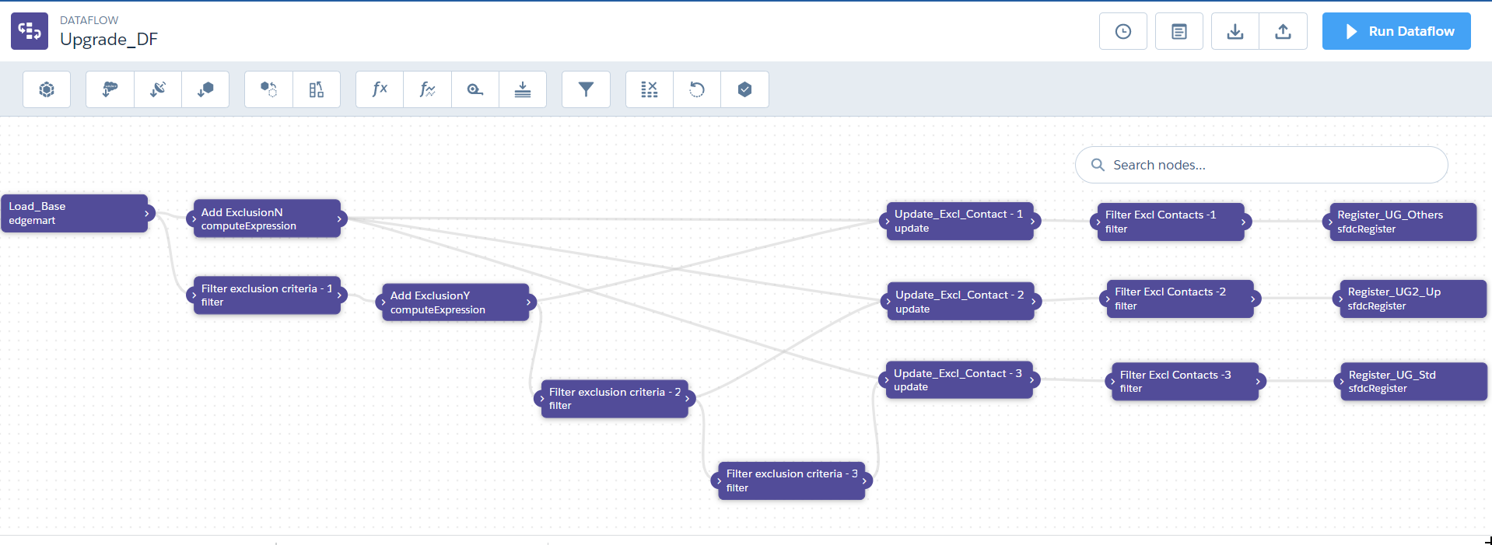
Dataflow Approach Page 3
Exclusion criteria that has subset criteria

Slide 14
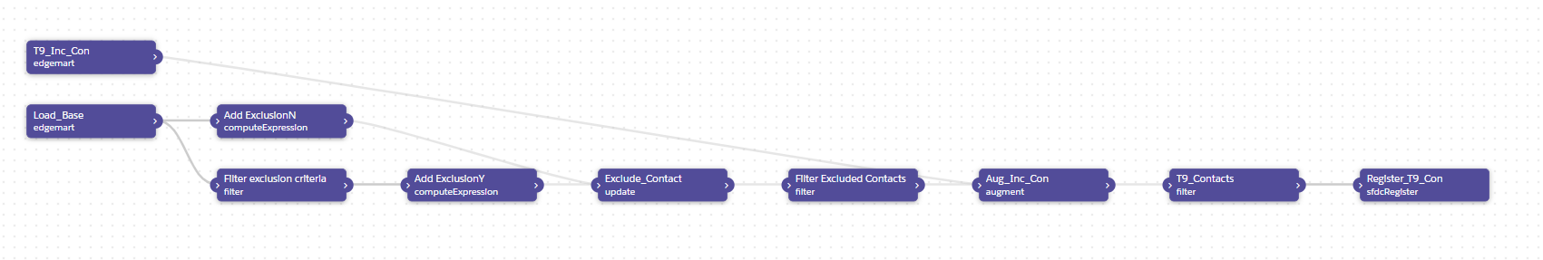
Dataflow Approach Page 4
Combination of 1 and 2

Slide 15
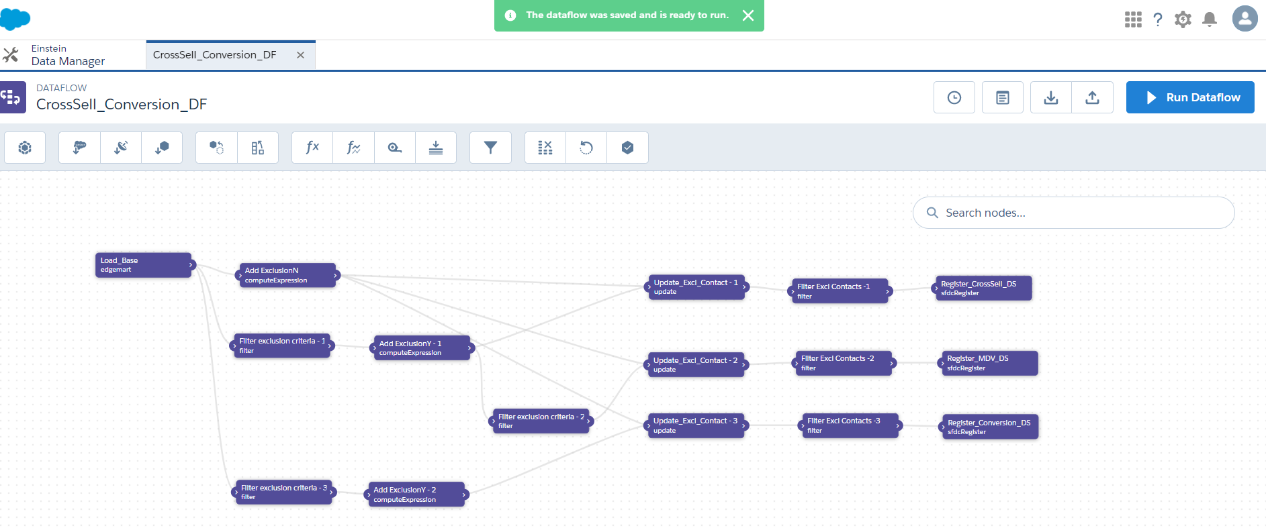
Dataflow Approach Page 5
Combination of 1 and 3

Slide 16
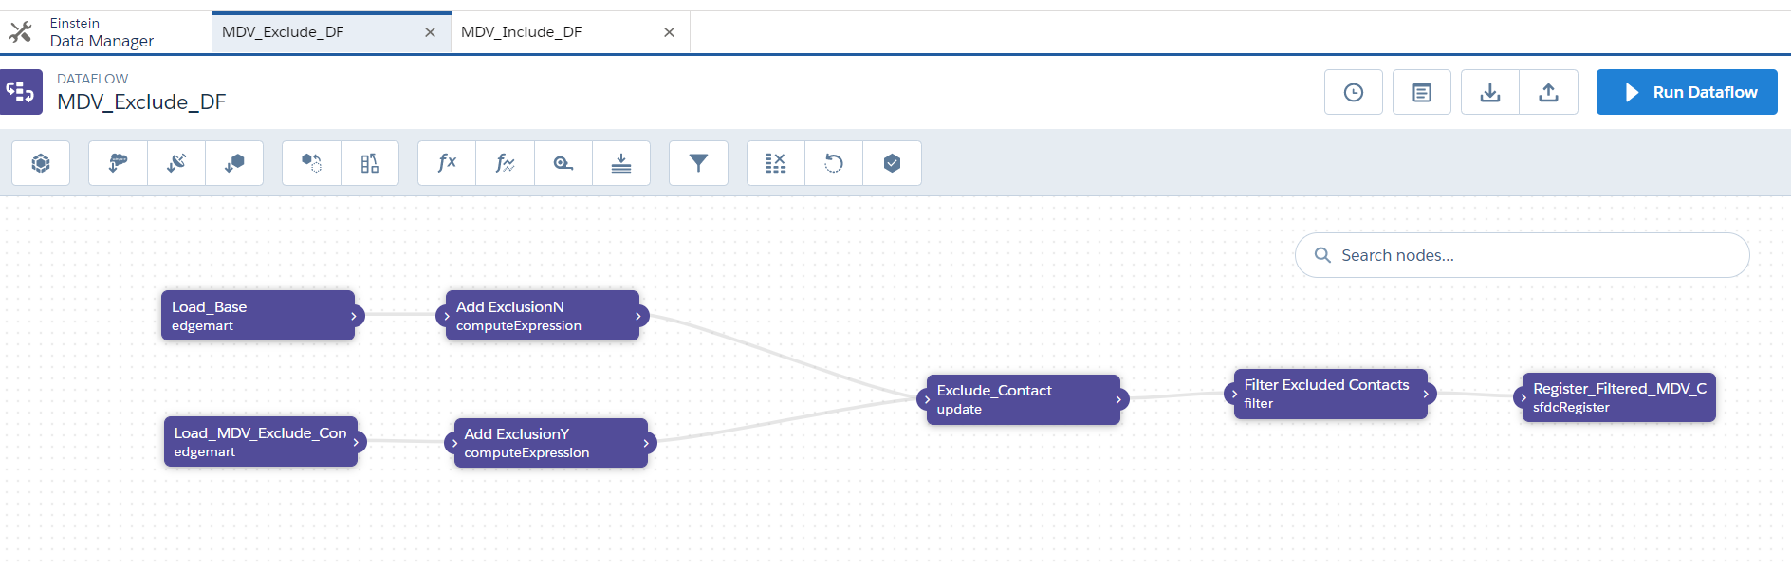
Dataflow Approach Page 6
Challenge | Decision
Exclude Contacts based on file upload. Joining datasets on Dashboard using Co-group gives Time out issue | 1) Use Datasets to upload the csv containing contacts to filter 2 ) Use Filter criteria in Dataflow to exclude.
Upload Contacts via csv and Filter them out.

Slide 17
Thank You
%j

